Slide 1
Chapter 4
Chapter 4
SNMPv1:
Organization and Information Models
Network Management: Principles and Practice
© Mani Subramanian 2000
4-1

Slide 2
Chapter 4
Case Histories
AT&T Network Management Centers
  Network Control Centers
  Network Operations Center
CNN World Headquarters
Centralized troubleshooting of NIC
Performance degradation due to NMS
Bell Operating company procedure
Notes
Network Management: Principles and Practice
© Mani Subramanian 2000
4-2

Slide 3
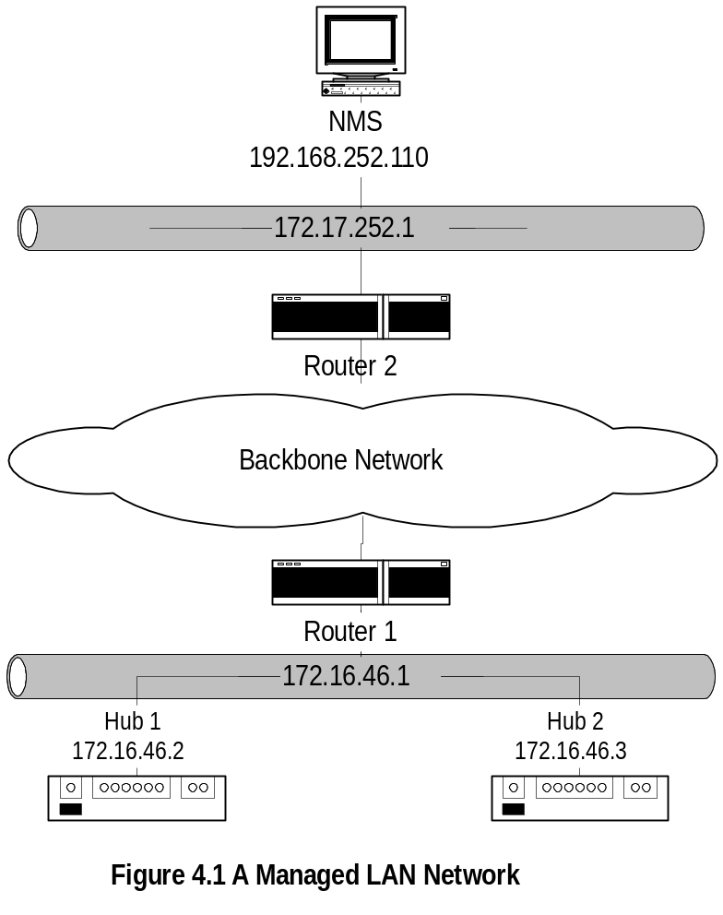
Chapter 4
Managed LAN
Notes
NMS on subnet 192.168.252.1 manages the router and
the hubs on subnet 172.16.46.1 across the backbone
network
Network Management: Principles and Practice
© Mani Subramanian 2000
4-3

Slide 4
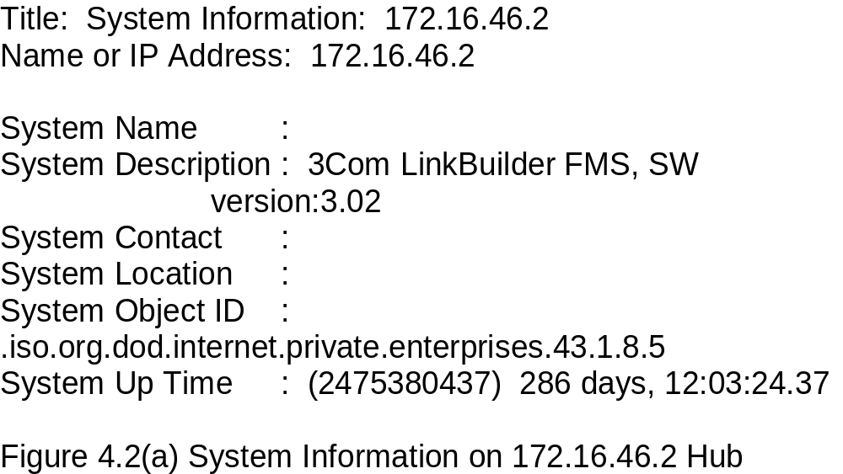
Chapter 4
Managed Hub:
System Information
Notes
Information obtained querying the hub
Data truly reflects what is stored in the hub
Network Management: Principles and Practice
© Mani Subramanian 2000
4-4

Slide 5
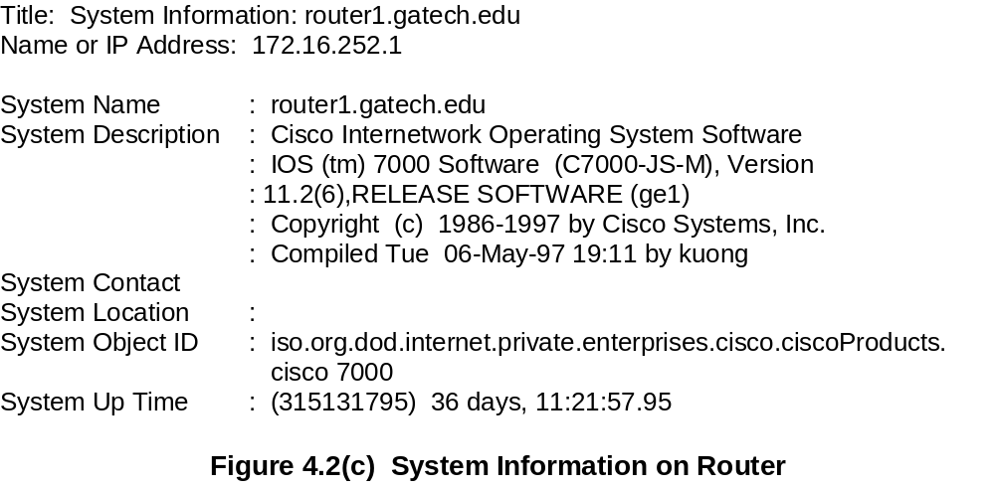
Chapter 4
Managed Router:
System Information
Notes
Network Management: Principles and Practice
© Mani Subramanian 2000
4-5

Slide 6
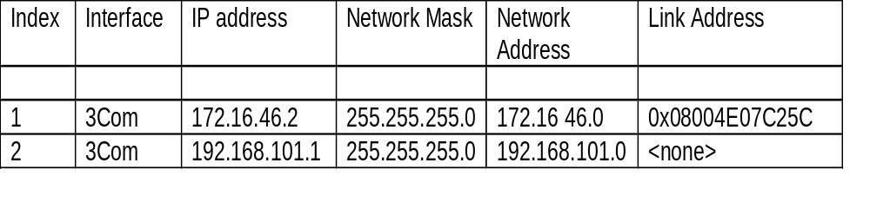
Chapter 4
Managed Hub:
Port Addresses
Notes
Information acquired by the NMS on hub interfaces
Index refers to the interface on the hub
Link address is the MAC address
The second row data is a serial link
Network Management: Principles and Practice
© Mani Subramanian 2000
4-6

Slide 7
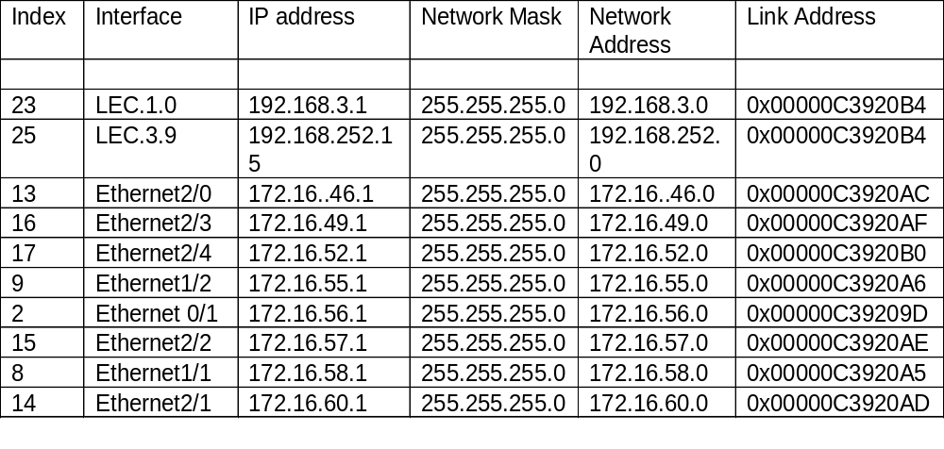
Chapter 4
Managed Router:
Port Addresses
Notes
Information acquired by NMS on the router interfaces
Index refers to the interface on the router
LEC is the LAN emulation card
Ethernet 2/0 interface refers to the interface
card 2 and port 0 in that card
Network Management: Principles and Practice
© Mani Subramanian 2000
4-7

Slide 8
Chapter 4
Internet SNMP Management
1970 Advanced Research Project Agency Network (ARPANET)
Internet control Message Protocol (ICMP)
Internet Engineering Task Force (IETF)
  1990 SNMPv1
  1995 SNMPv2
  1998 SNMPv3
Internet documents:
  Request for Comments (RFC)
  IETF STD Internet Standard
  FYI For your information
Source for RFCs
  ftp://nic.mil/rfc
  ftp://ftp.internic.net/rfc
  http://nic/internet.net/
Notes
Network Management: Principles and Practice
© Mani Subramanian 2000
4-8

Slide 9
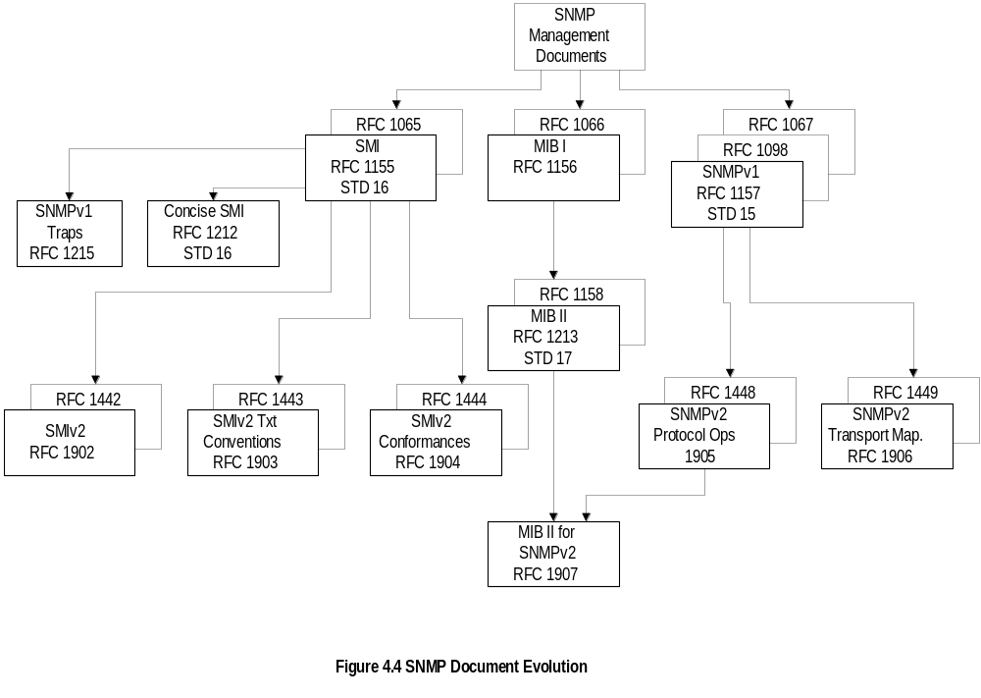
Chapter 4
SNMPv1 & SNMPv2
Documents
Network Management: Principles and Practice
© Mani Subramanian 2000
4-9

Slide 10
Chapter 4
SNMP Model
Organization Model
  Relationship between network element,
  agent, and manager
  Hierarchical architecture
Information Model
  Uses ASN.1 syntax
  SMI (Structure of Management Information
  MIB ( Management Information Base)
Communication Model
  Transfer syntax
  SNMP over TCP/IP
  Communication services addressed by messages
  Security framework community-based model
Notes
Network Management: Principles and Practice
© Mani Subramanian 2000
4-10

Slide 11
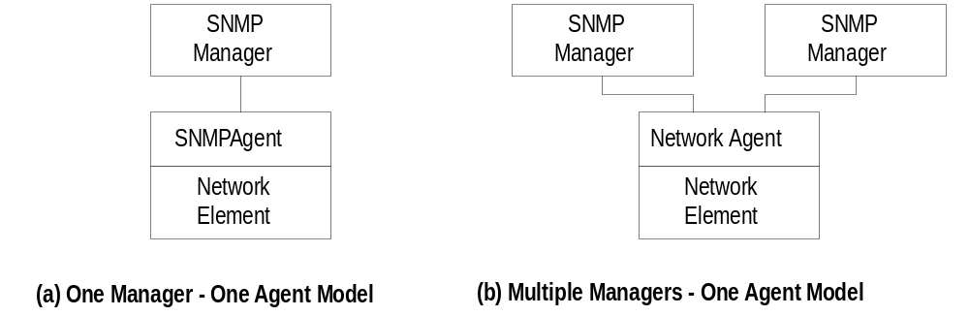
Chapter 4
Two-Tier Organization Model
Notes
Any host that could query an agent is a manager
Network Management: Principles and Practice
© Mani Subramanian 2000
4-11

Slide 12
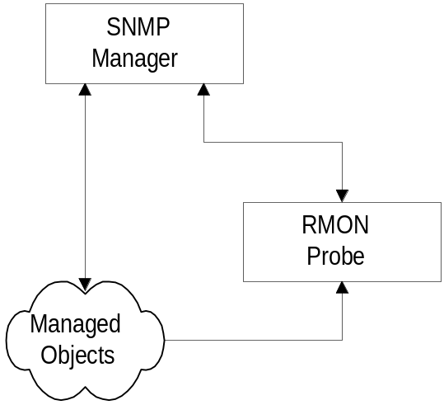
Chapter 4
Three-Tier Organization Model:
RMON
Notes
Managed object comprises network element and
management agent
RMON acts as an agent and a manager
RMON (Remote Monitoring) gathers data from MO,
analyses the data, and stores the data
Communicates the statistics to the manager
Network Management: Principles and Practice
© Mani Subramanian 2000
4-12

Slide 13
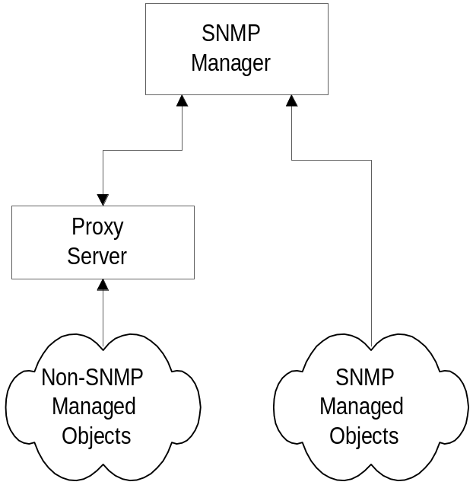
Chapter 4
Three-Tier Organization Model:
Proxy Server
Notes
Proxy server converts non-SNMP data from
non-SNMP objects to SNMP compatible objects
and messages
Network Management: Principles and Practice
© Mani Subramanian 2000
4-13

Slide 14
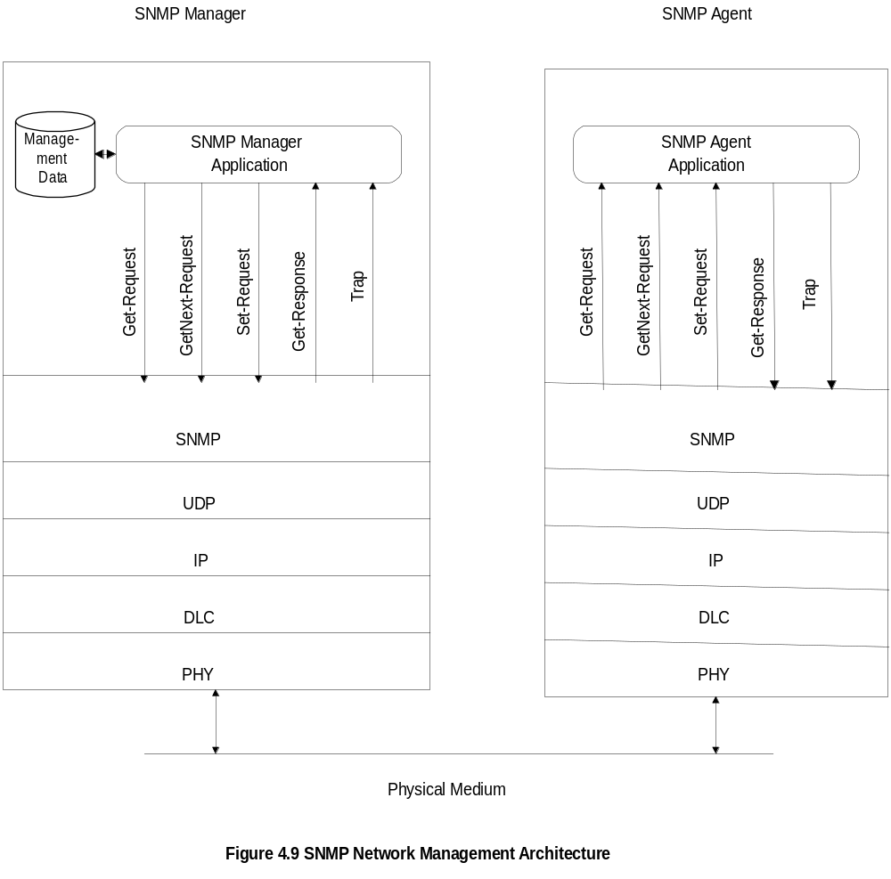
Chapter 4
System Architecture
Notes
Messages between manager and agent
Direction of messages - 3 from manager and
2 from agent
Network Management: Principles and Practice
© Mani Subramanian 2000
4-14

Slide 15
Chapter 4
SNMP Messages
Get-Request
  Sent by manager requesting data from agent
Get-Next-Request
  Sent by manager requesting data on the next
  MO to the one specified
Set-Request
  Initializes or changes the value of network
  element
Get-Response
  Agent responds with data for get and set
  requests from the manager
Trap
  Alarm generated by an agent
Notes
Network Management: Principles and Practice
© Mani Subramanian 2000
4-15

Slide 16
Chapter 4
Information
Structure of Management Information (SMI)
(RFC 1155)
Managed Object
  Scalar
  Aggregate or tabular object
Management Information Base (RFC 1213)
Notes
RFCs can be downloaded from ftp.internic.net/rfc
Network Management: Principles and Practice
© Mani Subramanian 2000
4-16

Slide 17
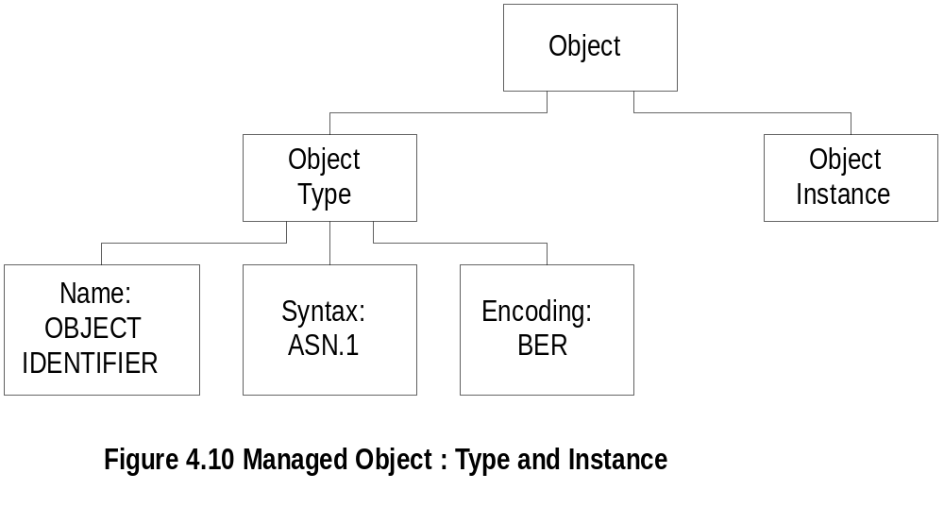
Chapter 4
Managed Object
Notes
Object type and data type are synonymous
Object identifier is data type, not instance
Object instance IP address (See Figure 4.2)
Network Management: Principles and Practice
© Mani Subramanian 2000
4-17

Slide 18
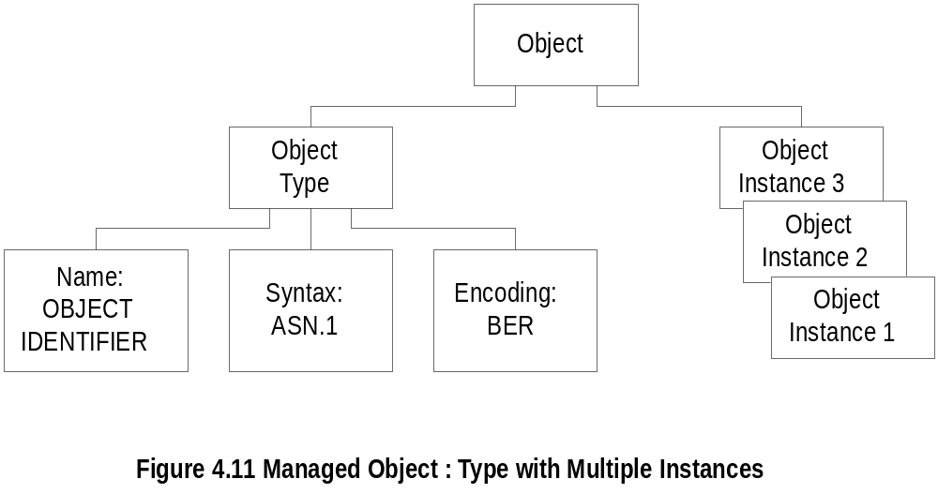
Chapter 4
Managed Object: Multiple Instances
Notes
All 3 Com hubs of the same version have identical
identifier; they are distinguished by the IP address
Each IP address is an instance of the object
Network Management: Principles and Practice
© Mani Subramanian 2000
4-18

Slide 19

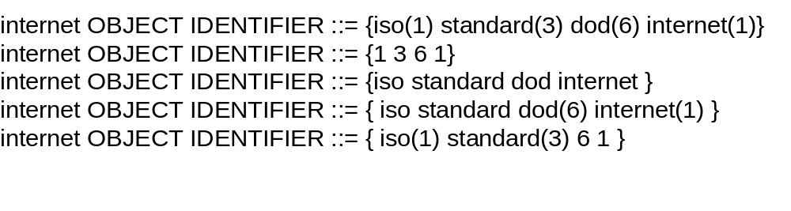
Chapter 4
Name
Uniquely defined by
  DESCRIPTOR AND
  OBJECT IDENTIFIER
Notes
Example
ipAddrTable ip 20
Network Management: Principles and Practice
© Mani Subramanian 2000
4-19

Slide 20
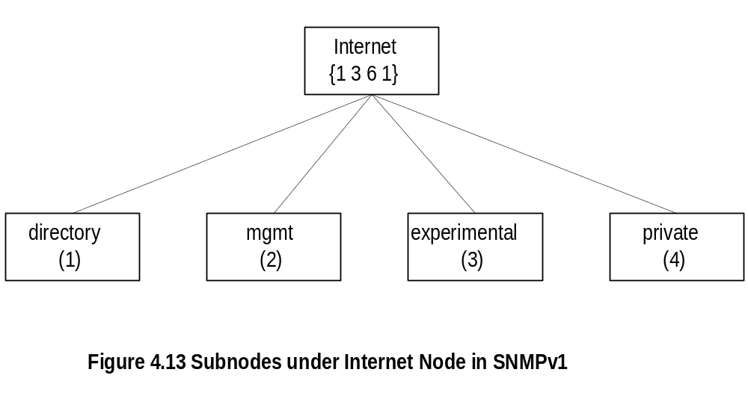
Chapter 4
Internet Subnodes
Notes
directory OBJECT IDENTIFIER ::= {internet 1}
mgmt OBJECT IDENTIFIER ::= {internet 2}
experimental OBJECT IDENTIFIER ::= {internet 3}
private OBJECT IDENTIFIER ::= {internet 4}
Network Management: Principles and Practice
© Mani Subramanian 2000
4-20

Slide 21
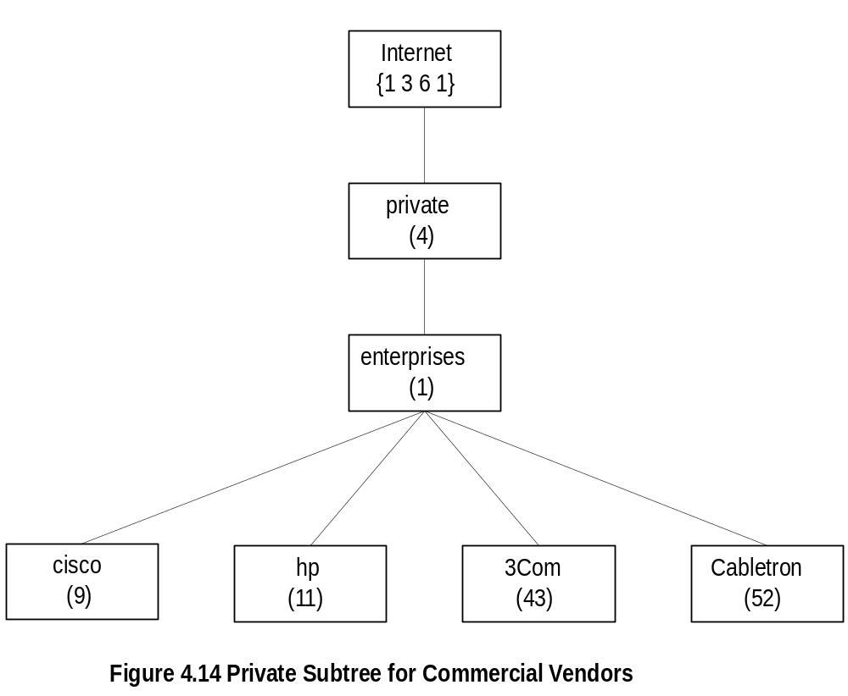
Chapter 4
Private MIB Example
Notes
private MIB intended for vendor equipment
IANA (Internet Assigned Numbers Authority) assigns
identifiers
Network Management: Principles and Practice
© Mani Subramanian 2000
4-21

Slide 22
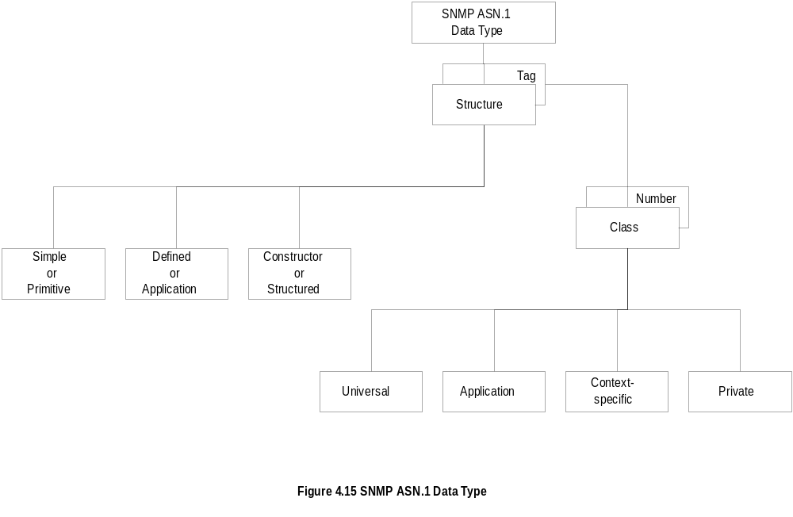
Chapter 4
SNMP ASN.1 Data Type
Network Management: Principles and Practice
© Mani Subramanian 2000
4-22

Slide 23
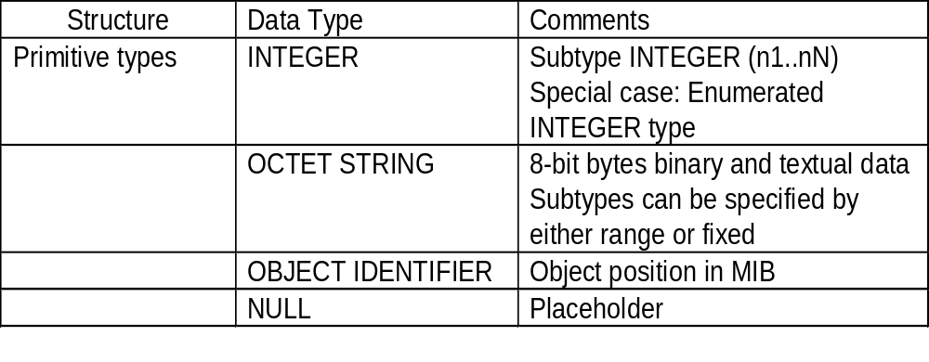
Chapter 4
Primitive Data Types
Notes
get-request message has NULL for value fields and
get-response from agent has the values filled in
subtype:
  INTEGER (0..255)
  OCTET STRING (SIZE 0..255)
  OCTET STRING (SIZE 8)
Network Management: Principles and Practice
© Mani Subramanian 2000
4-23

Slide 24
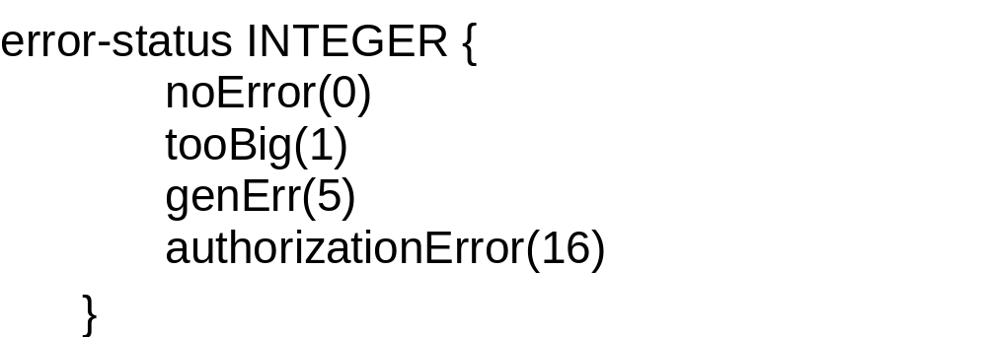
Chapter 4
Enumerated
Special case of INTEGER data type
Notes
noError NULL by convention
Network Management: Principles and Practice
© Mani Subramanian 2000
4-24

Slide 25
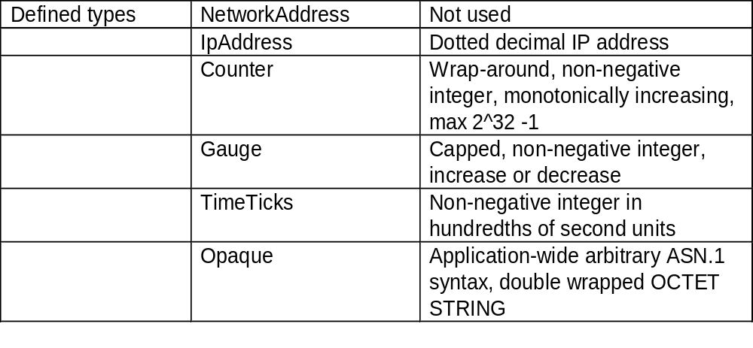
Chapter 4
Defined or Application Data Type
Notes
Defined data types are simple or base types
Opaque is used to create data types based on
previously defined data types
Network Management: Principles and Practice
© Mani Subramanian 2000
4-25

Slide 26
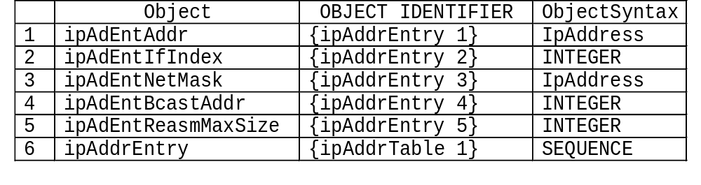
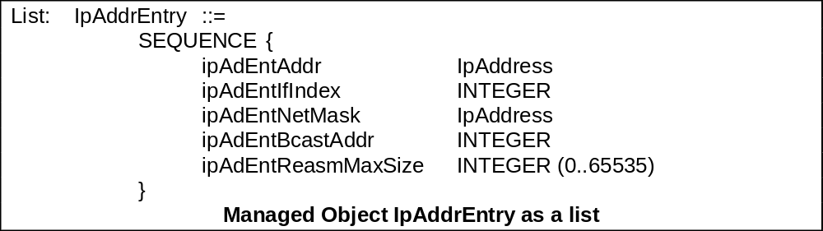
Chapter 4
Constructor or Structured Data Type:
SEQUENCE
List maker
Notes
Network Management: Principles and Practice
© Mani Subramanian 2000
4-26

Slide 27
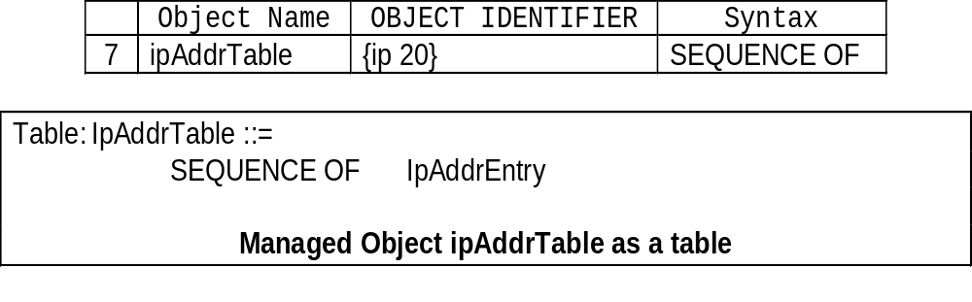
Chapter 4
Constructor or Structured Data Type:
SEQUENCE OF
Notes
Network Management: Principles and Practice
© Mani Subramanian 2000
4-27

Slide 28
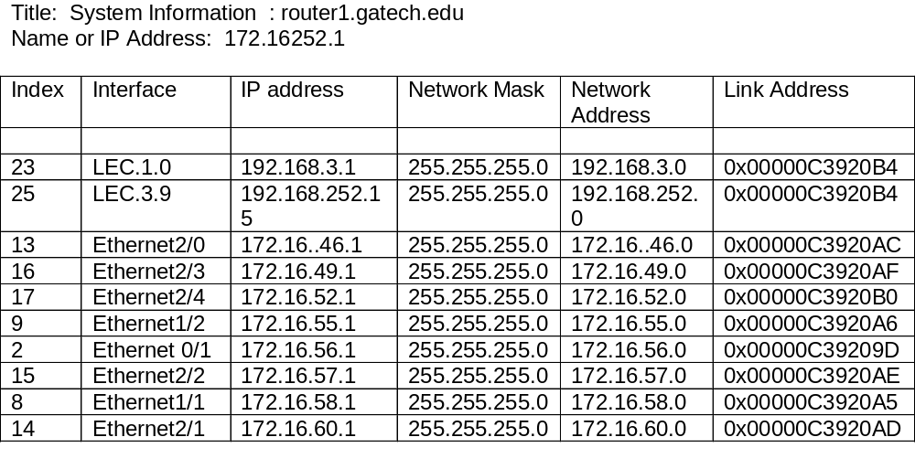
Chapter 4
SEQUENCE OF Example
Notes
The above example (Figure 4.3) uses part of the
IP MIB discussed for SEQUENCE OF construct
Network Management: Principles and Practice
© Mani Subramanian 2000
4-28

Slide 29
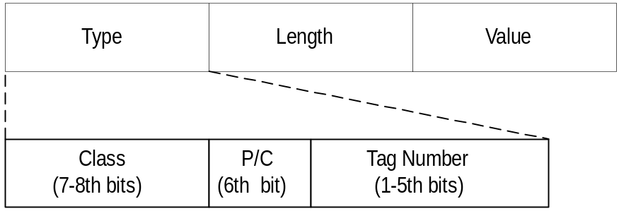
Chapter 4
Encoding
Basic Encoding Rules (BER)
  Tag, Length, and Value (TLV)
SNMP Data Types and Tags
Type Tag
OBJECT IDENTIFIER UNIVERSAL 6
SEQUENCE UNIVERSAL 16
IpAddress APPLICATION 0
Counter APPLICATION 1
Gauge APPLICATION 2
TimeTicks APPLICATION 3
Opaque APPLICATION 4
Notes
Network Management: Principles and Practice
© Mani Subramanian 2000
4-29

Slide 30
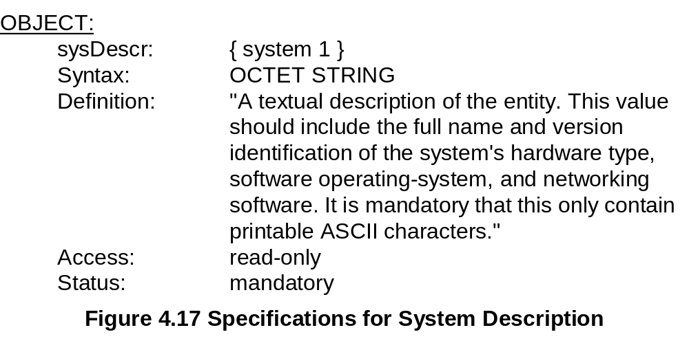
Chapter 4
Managed Object: Structure
Notes
Network Management: Principles and Practice
© Mani Subramanian 2000
4-30

Slide 31
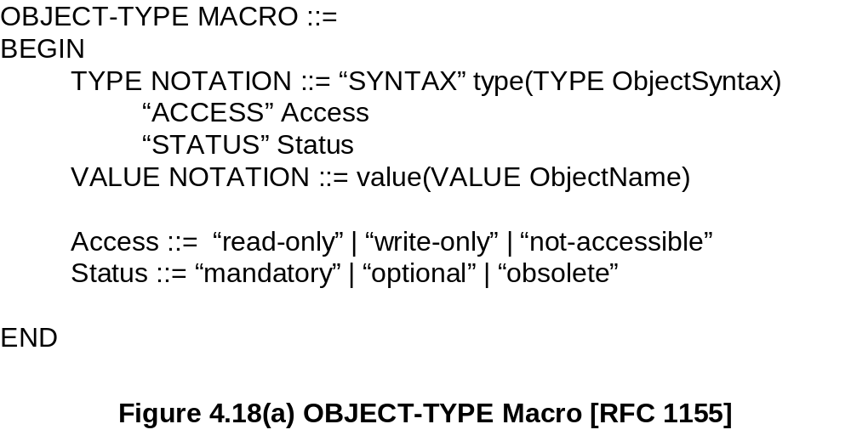
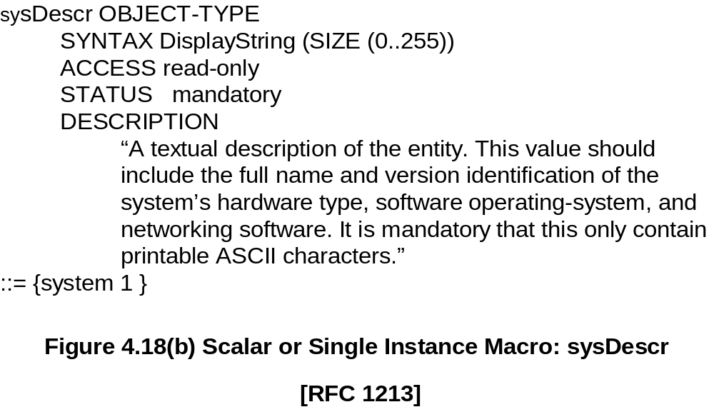
Chapter 4
Managed Object: Macro
Notes
Network Management: Principles and Practice
© Mani Subramanian 2000
4-31

Slide 32
Chapter 4
Aggregate Object
A group of objects
Also called tabular objects
Can be represented by a table with
  Columns of objects
  Rows of instances
Table of Objects
List of Objects
Objects
Notes
Example: IP address table
Consists of objects:
  IP address
  Interface
  Subnet mask (which subnet this address
  belongs to)
  Broadcast address (value of l.s.b. in IP
  broadcast address)
  Largest IP datagram that can be assembled
Multiple instances of these objects associated with
the node
Network Management: Principles and Practice
© Mani Subramanian 2000
4-32

Slide 33
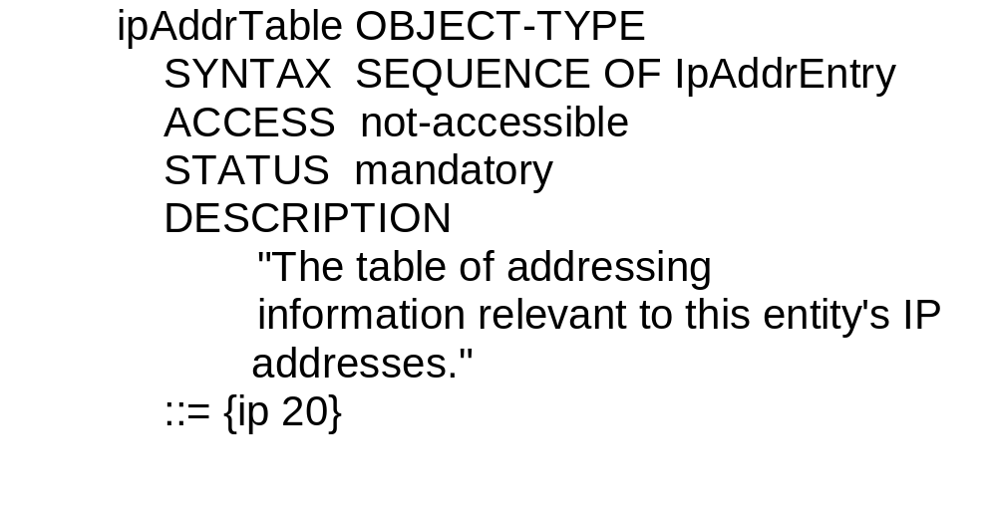
Chapter 4
Aggregate M.O. Macro:
Table Object
Notes
ipAddrTable OBJECT-TYPE
::= {ip 20}
ipAddrEntry OBJECT-TYPE
::= {ipAddrTable 1}
Network Management: Principles and Practice
© Mani Subramanian 2000
4-33

Slide 34
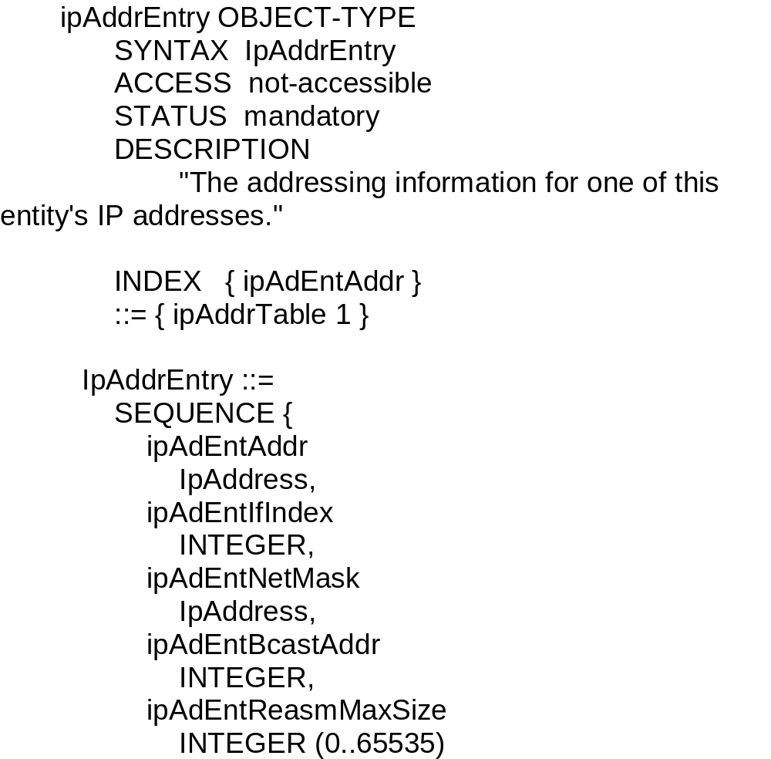
Chapter 4
Aggregate M.O. Macro:
Entry Object
Notes
Index ipAdEntAddr uniquely identifies an instance
May require more than one object in the instance to
uniquely identify it
Network Management: Principles and Practice
© Mani Subramanian 2000
4-34

Slide 35
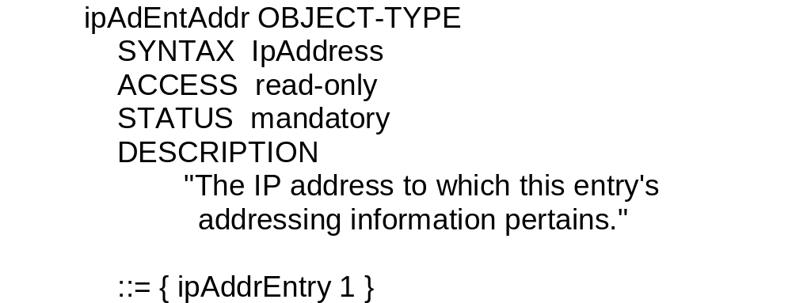
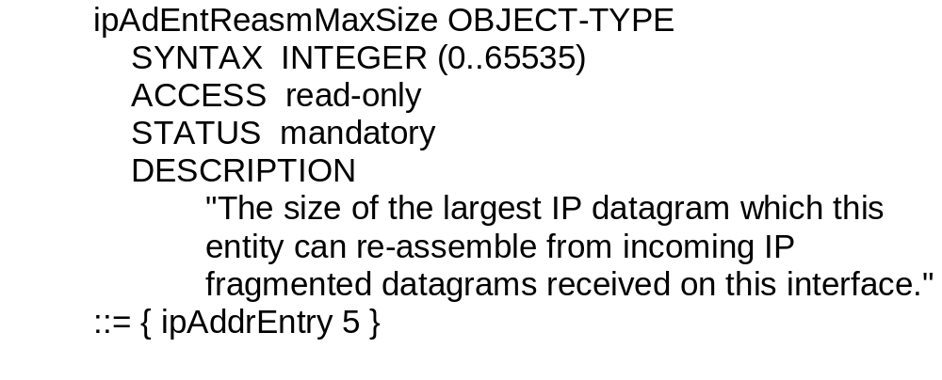
Chapter 4
Aggregate M.O. Macro:
Columnar Objects
Notes
Network Management: Principles and Practice
© Mani Subramanian 2000
4-35

Slide 36
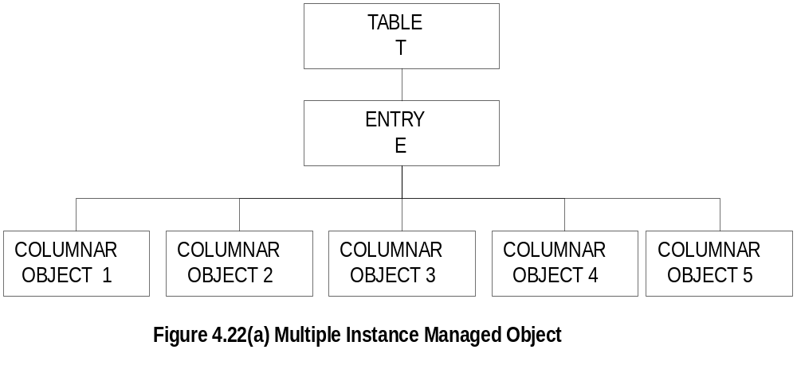
Chapter 4
Tabular Representation of
Aggregate Object
Notes
The objects TABLE T and ENTRY E are objects that
are logical objects. They define the grouping and are
not accessible
Columnar objects are objects that represent the
attributes and hence are accessible
Each instance of E is a row of columnar objects
1 through 5
Multiple instances of E are represented by multiple rows
Network Management: Principles and Practice
© Mani Subramanian 2000
4-36

Slide 37
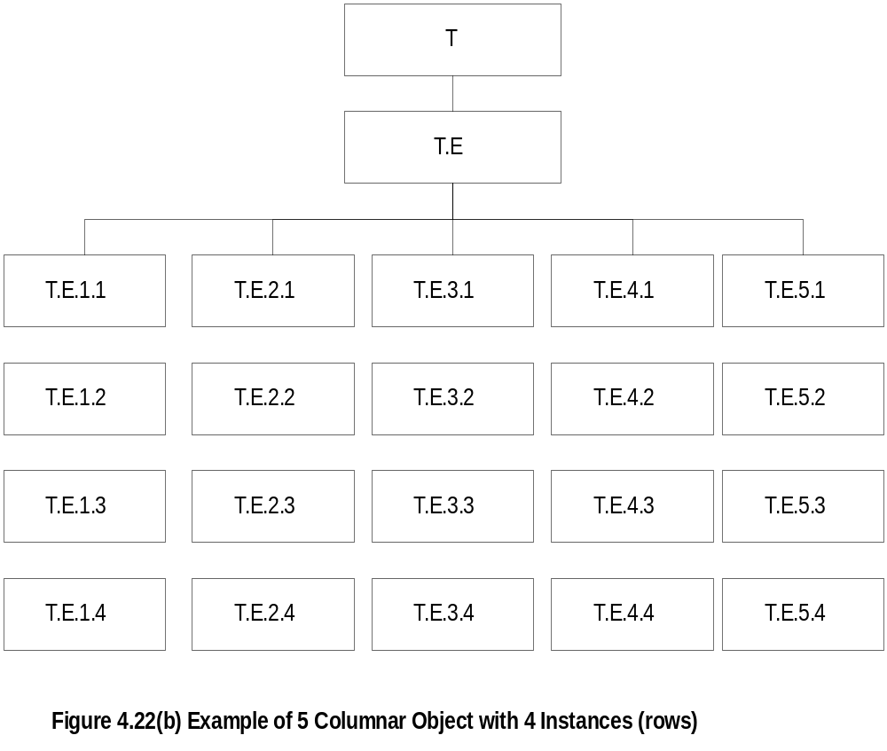
Chapter 4
Tabular Representation of
Aggregate Object
Notes
Notice that the column-row numeric designation is
reverse of what we are used to as row-column
Network Management: Principles and Practice
© Mani Subramanian 2000
4-37

Slide 38
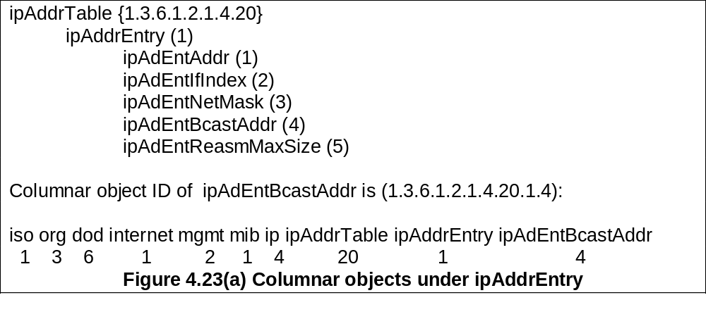
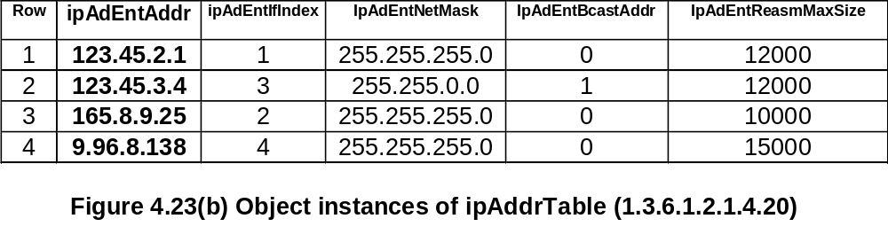
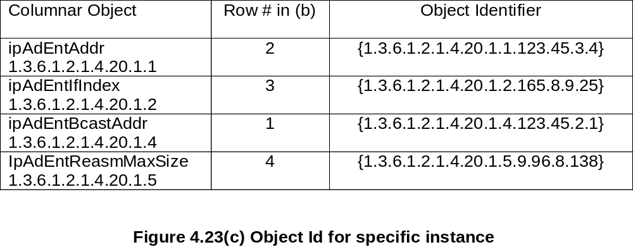
Chapter 4
Multiple Instances of
Aggregate Managed Object
Network Management: Principles and Practice
© Mani Subramanian 2000
4-38

Slide 39
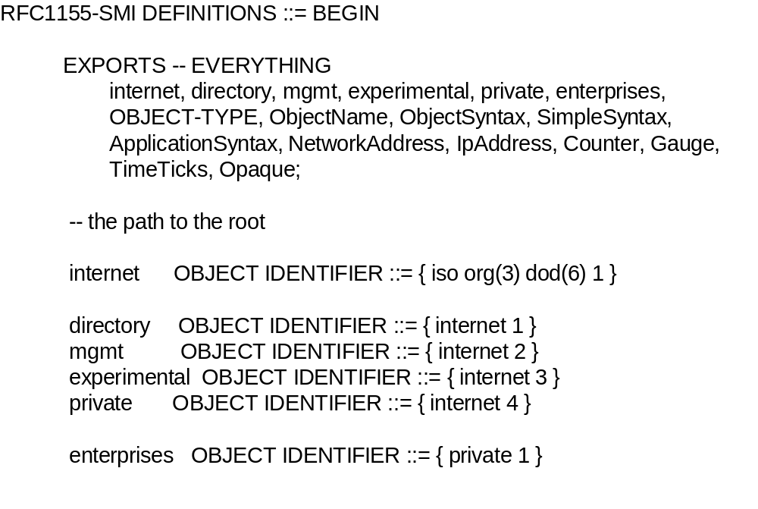
Chapter 4
SMI Definition STD 16 / 1155 RFC
Notes
EXPORTS identifies the objects that any other module
could import
Network Management: Principles and Practice
© Mani Subramanian 2000
4-39

Slide 40
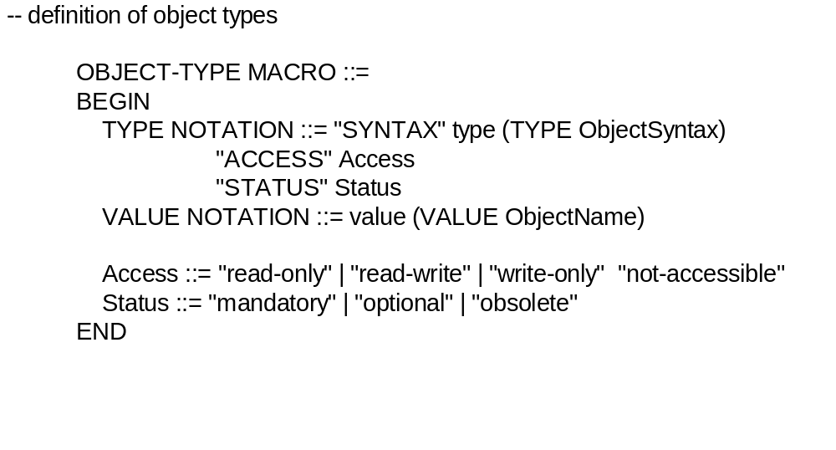
Chapter 4
SMI Definition STD 16 / 1155 RFC
Notes
Network Management: Principles and Practice
© Mani Subramanian 2000
4-40

Slide 41
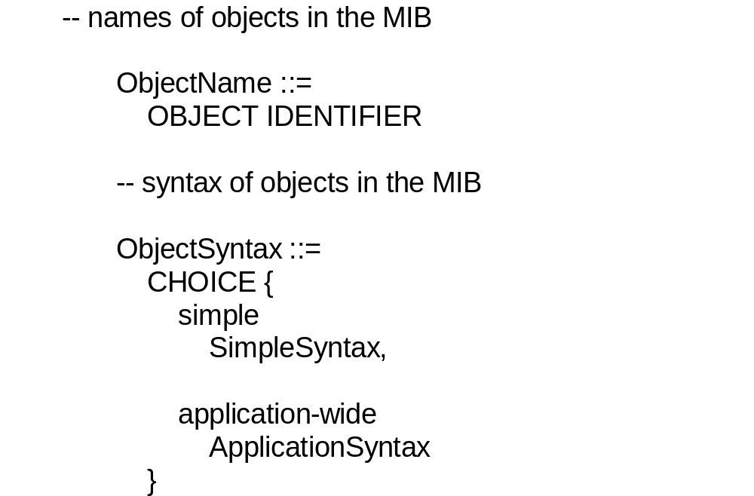
Chapter 4
SMI Definition STD 16 / 1155 RFC
Notes
Network Management: Principles and Practice
© Mani Subramanian 2000
4-41

Slide 42
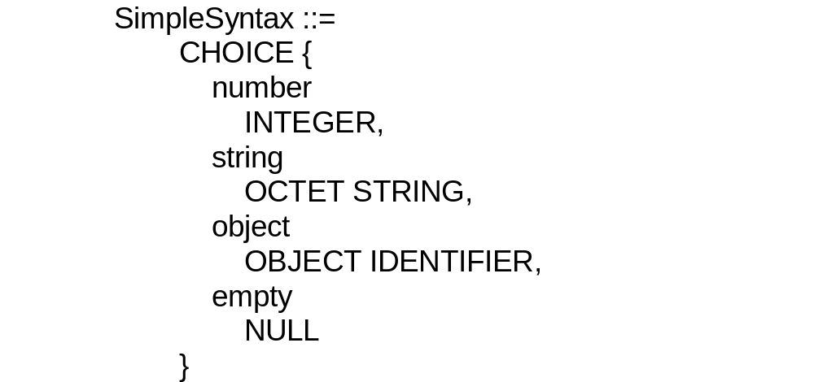
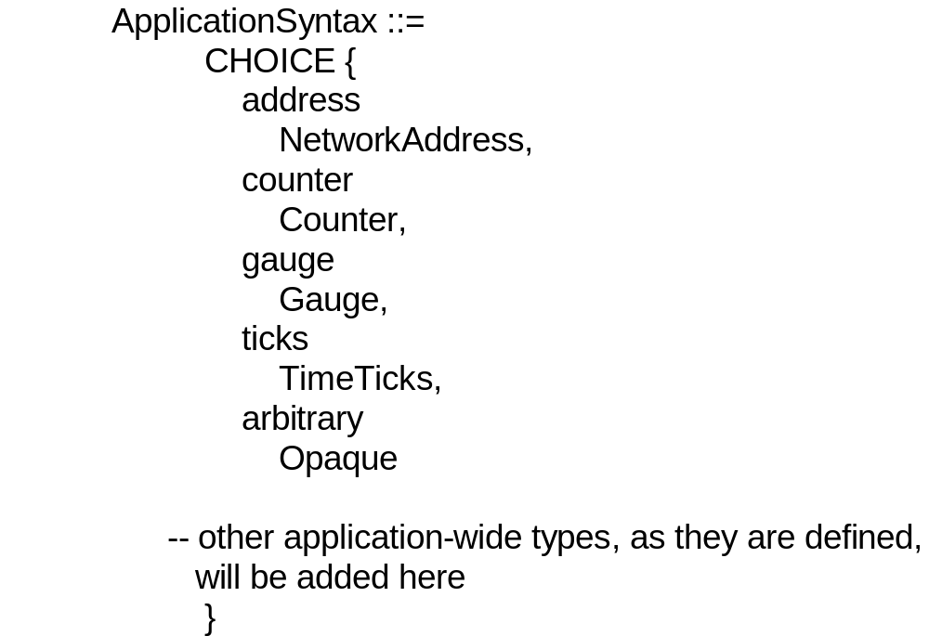
Chapter 4
SMI Definition STD 16 / 1155 RFC
Network Management: Principles and Practice
© Mani Subramanian 2000
4-42

Slide 43
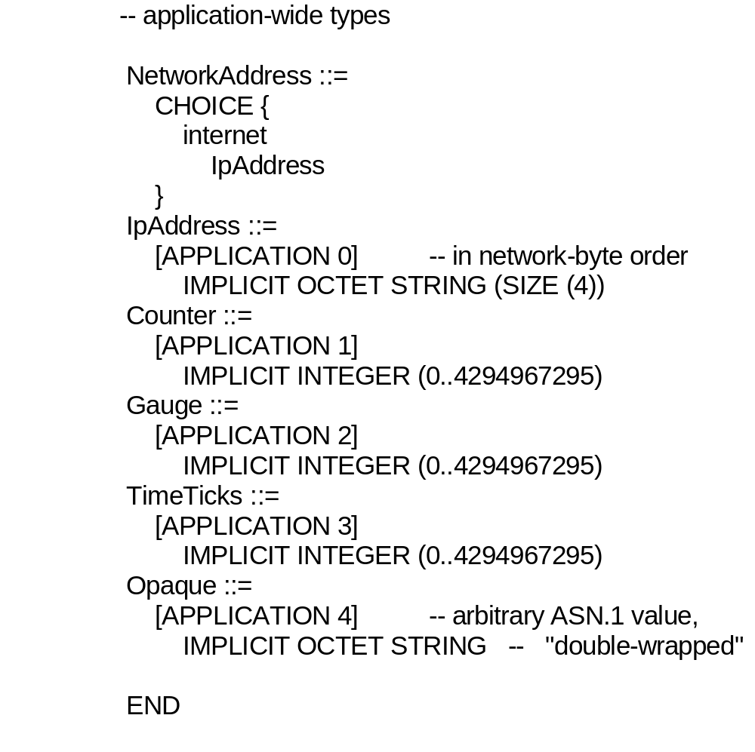
Chapter 4
SMI Definition STD 16 / 1155 RFC
Notes
Network Management: Principles and Practice
© Mani Subramanian 2000
4-43

Slide 44
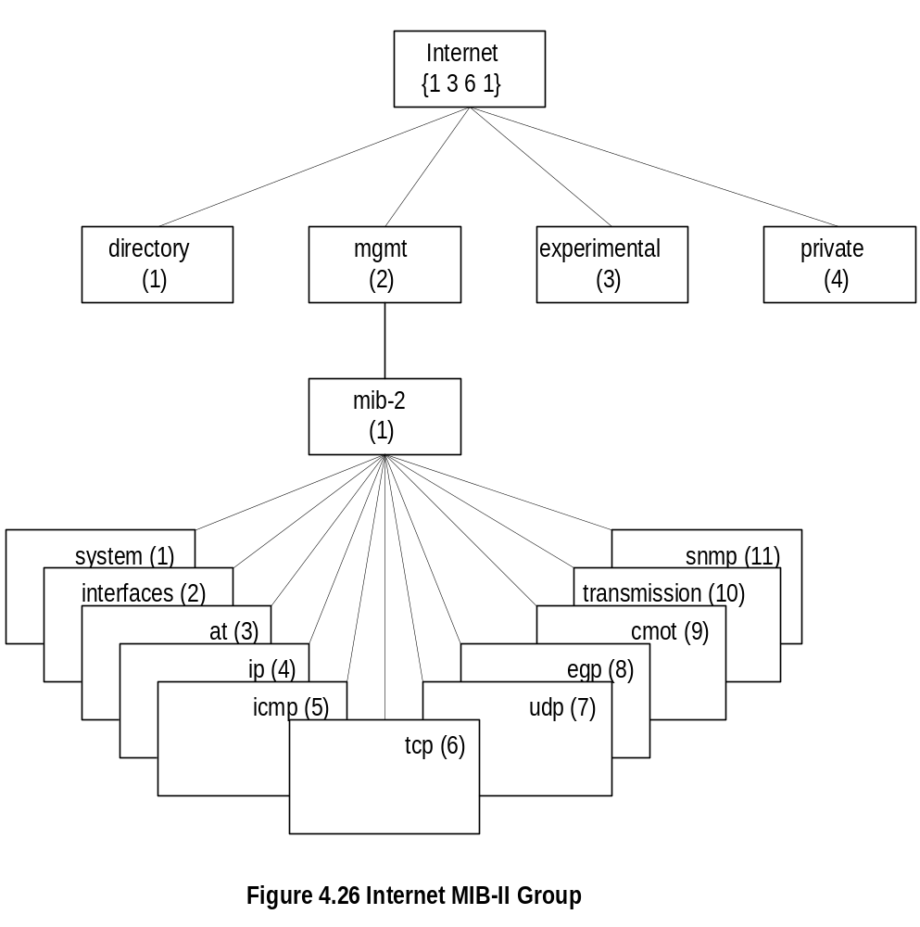
Chapter 4
MIB
Notes
MIB-II (RFC 1213) is superset of MIB-I
Objects that are related grouped into object groups
MIB module comprises module name, imports from
other modules, and definitions of current module
RFC 1213 defines eleven groups; expanded later
Network Management: Principles and Practice
© Mani Subramanian 2000
4-44

Slide 45
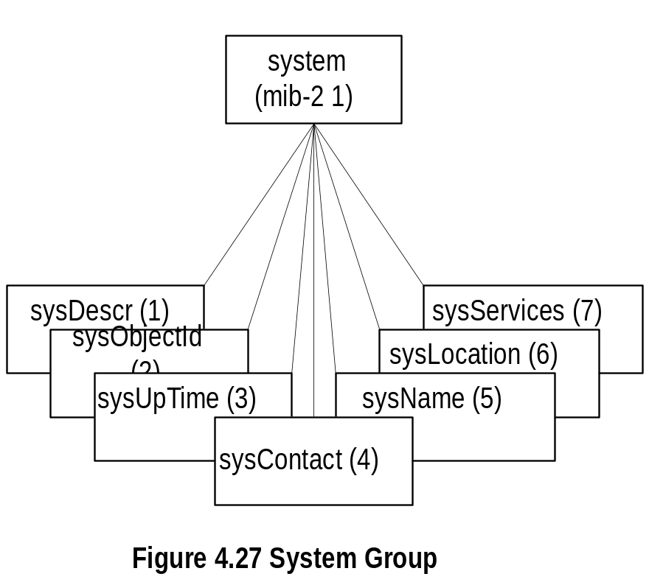
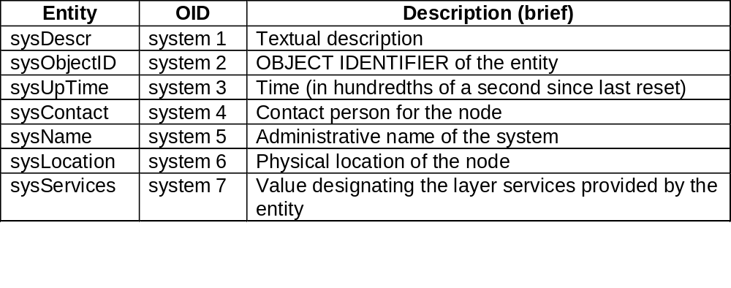
Chapter 4
System Group
Notes
Network Management: Principles and Practice
© Mani Subramanian 2000
4-45

Slide 46
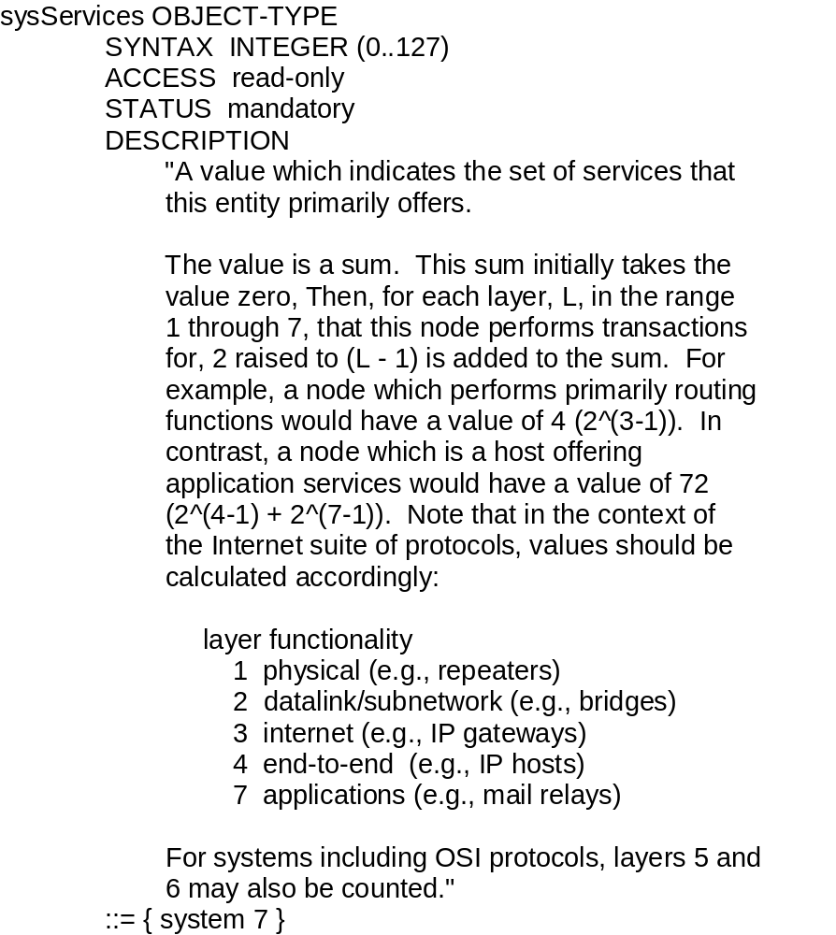
Chapter 4
sysServices
Notes
Network Management: Principles and Practice
© Mani Subramanian 2000
4-46

Slide 47
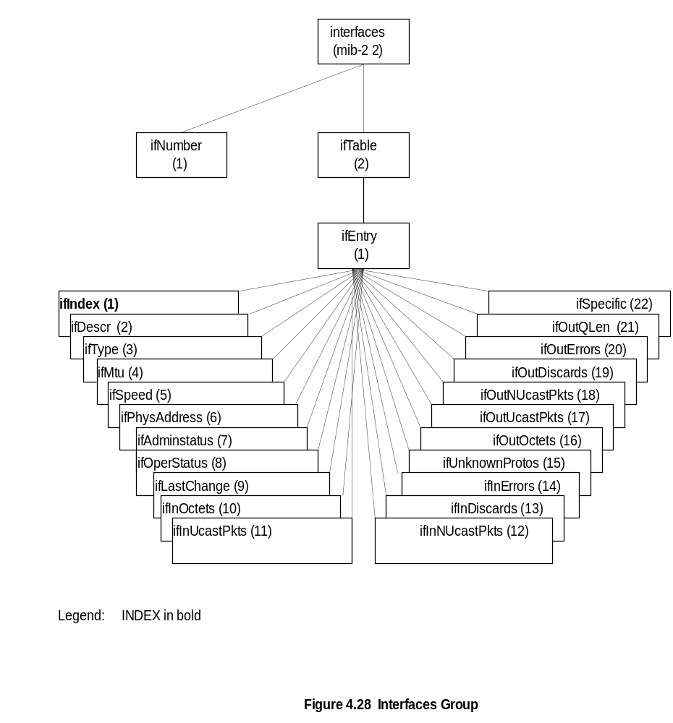
Chapter 4
Interfaces Group
Notes
Network Management: Principles and Practice
© Mani Subramanian 2000
4-47

Slide 48
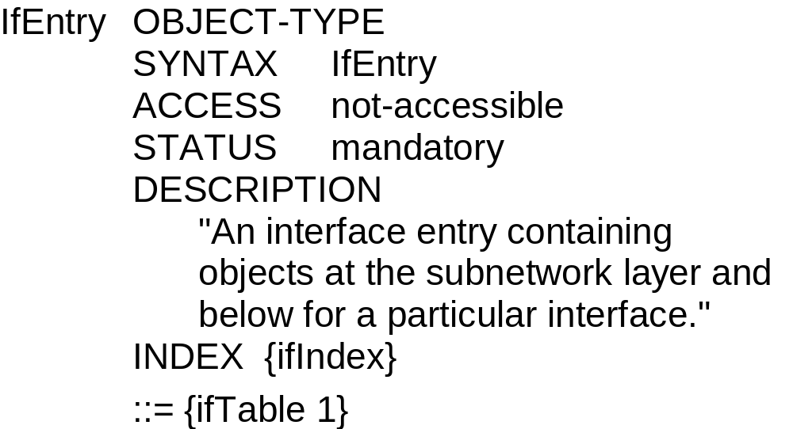
Chapter 4
ifEntry
Notes
ifEntry specifies the objects in a row in the ifTable
Each interface is defined as a row in the table
Network Management: Principles and Practice
© Mani Subramanian 2000
4-48

Slide 49
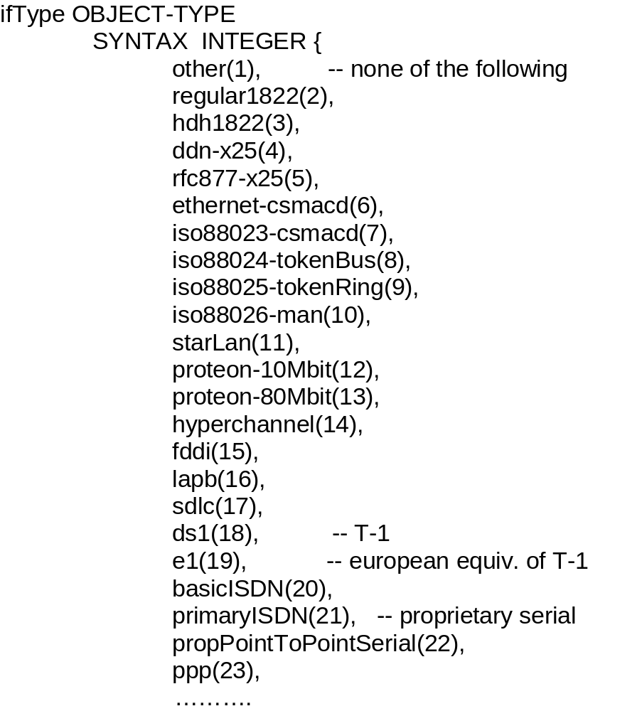
Chapter 4
ifType
Notes
Type of interface below the network layer defined as
enumerated integer
Network Management: Principles and Practice
© Mani Subramanian 2000
4-49

Slide 50
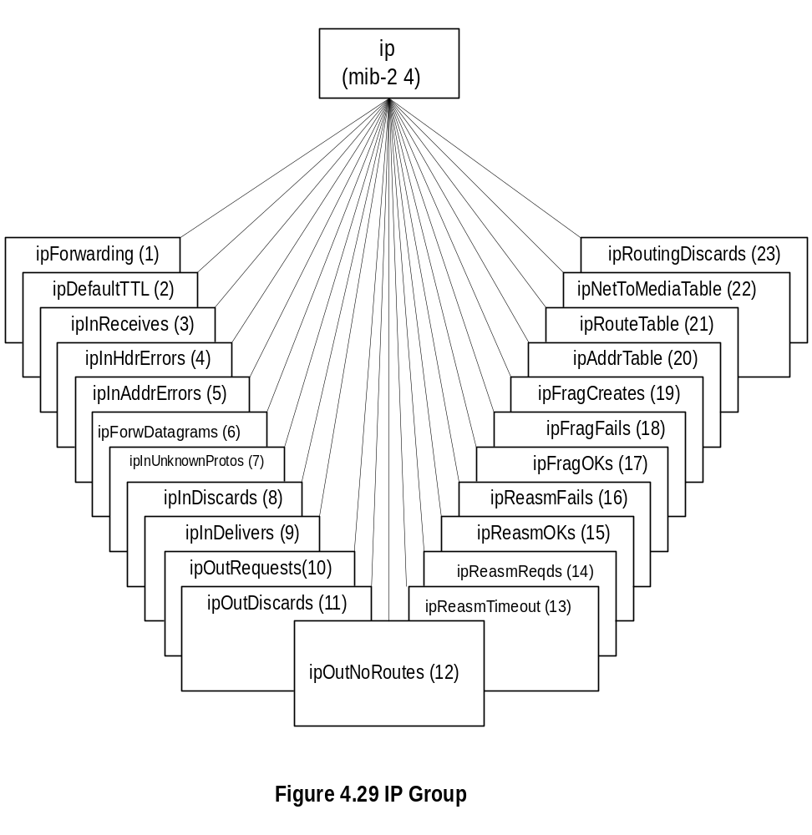
Chapter 4
IP Group
Notes
ipForwarding: Gateway(1) and Router(2)
IP Address Table contains table of IP addresses
IP Route Table contains an entry for each route
IP Network-to-Media Table is address translation table
mapping IP addresses to physical addresses
Network Management: Principles and Practice
© Mani Subramanian 2000
4-50

Slide 51


Chapter 4
IP Address Table
Notes
Network Management: Principles and Practice
© Mani Subramanian 2000
4-51

Slide 52


Chapter 4
IP Routing Table
Network Management: Principles and Practice
© Mani Subramanian 2000
4-52

Slide 53


Chapter 4
IP Address Translation Table
Notes
Network Management: Principles and Practice
© Mani Subramanian 2000
4-53

Slide 54

Chapter 4
ICMP Group
Notes
Objects associated with ping
  icmpOutEchos # ICMP echo messages sent
  icmpInEchoReps # ICMP echo reply messages
  received
Objects associated with traceroute/tracert
  icmpInTimeExcs # ICMP time exceeded messages received
Network Management: Principles and Practice
© Mani Subramanian 2000
4-54

Slide 55

Chapter 4
TCP Group
Notes
Connection-oriented transport protocol group
Has one table
Network Management: Principles and Practice
© Mani Subramanian 2000
4-55

Slide 56


Chapter 4
TCP Connection Table
Notes
Network Management: Principles and Practice
© Mani Subramanian 2000
4-56

Slide 57


Chapter 4
UDP Group
Notes
Connectionless transport protocol group
Has one table, UDP table
Network Management: Principles and Practice
© Mani Subramanian 2000
4-57

